Slide 1
Personal KanbanBoard

Slide 2
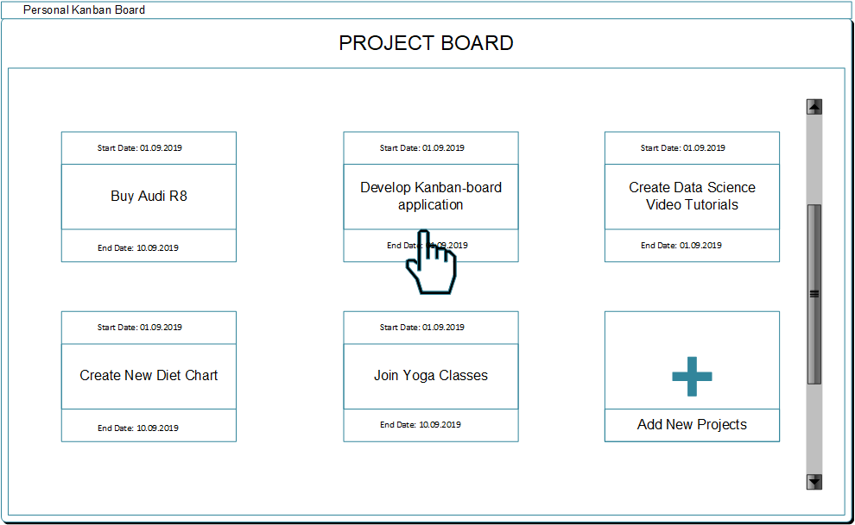
Wire-frames

Slide 3
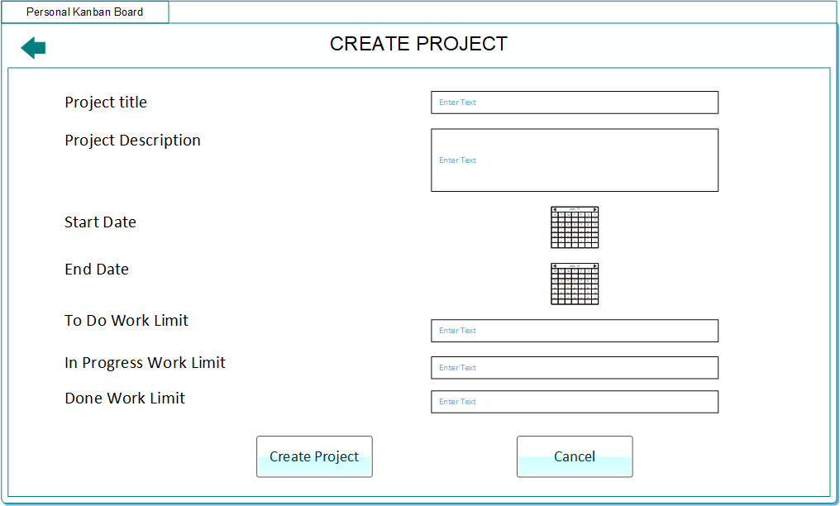
Wire-frames

Slide 4
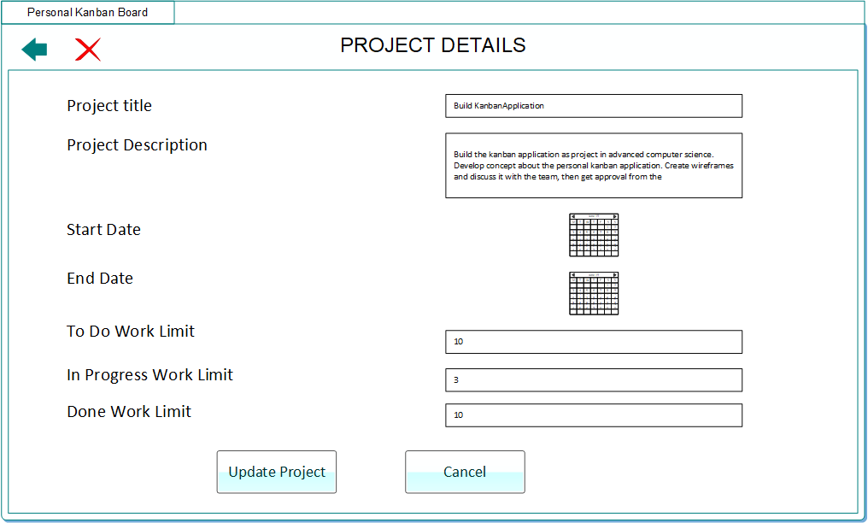
Wire-frames

Slide 5
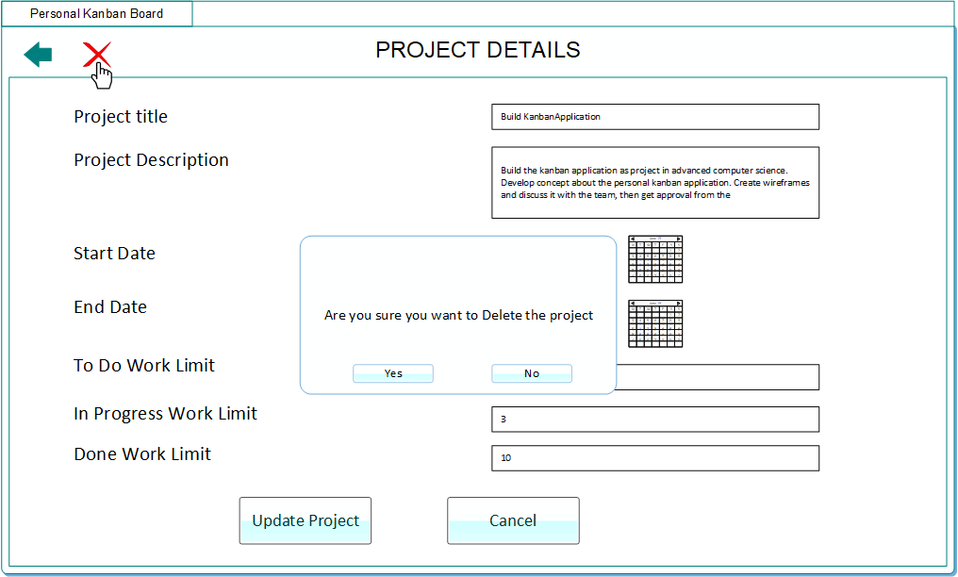
Wire-frames

Slide 6
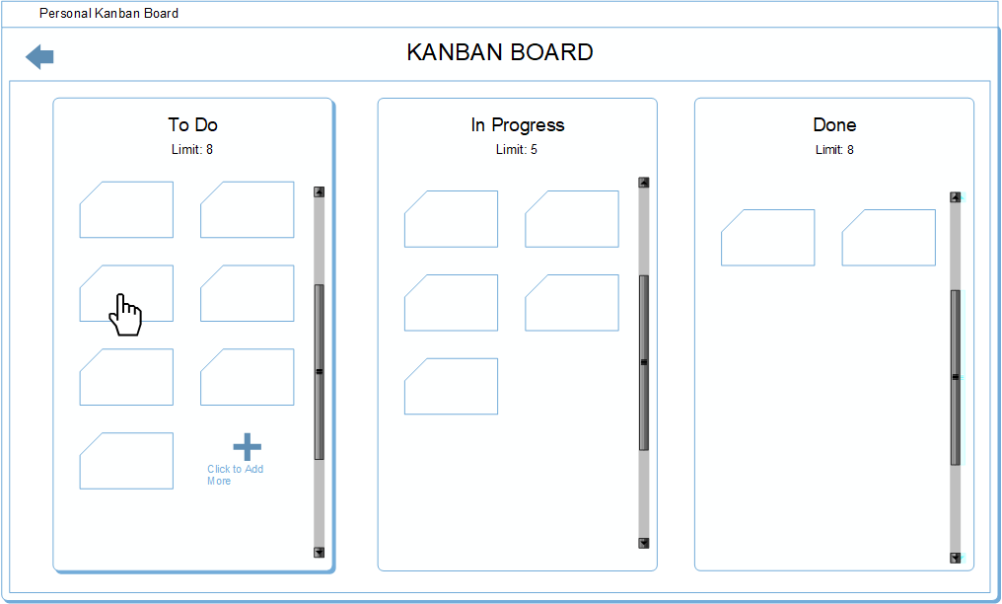
Wire-frames

Slide 7
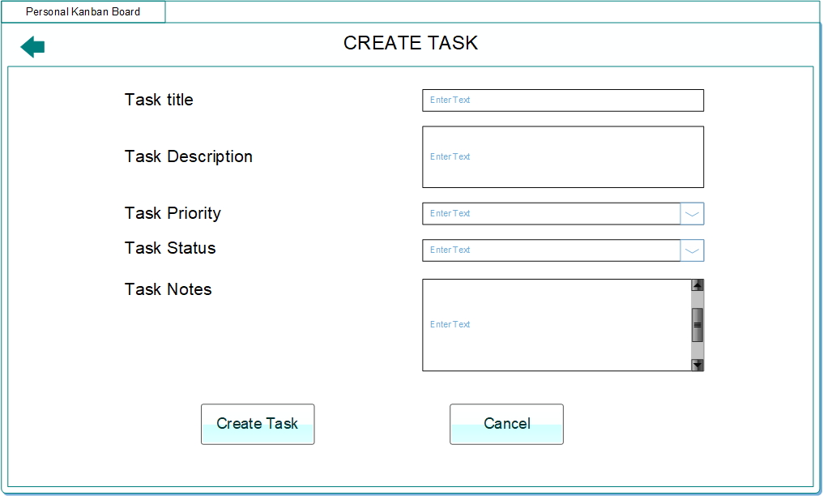
Wire-frames

Slide 8
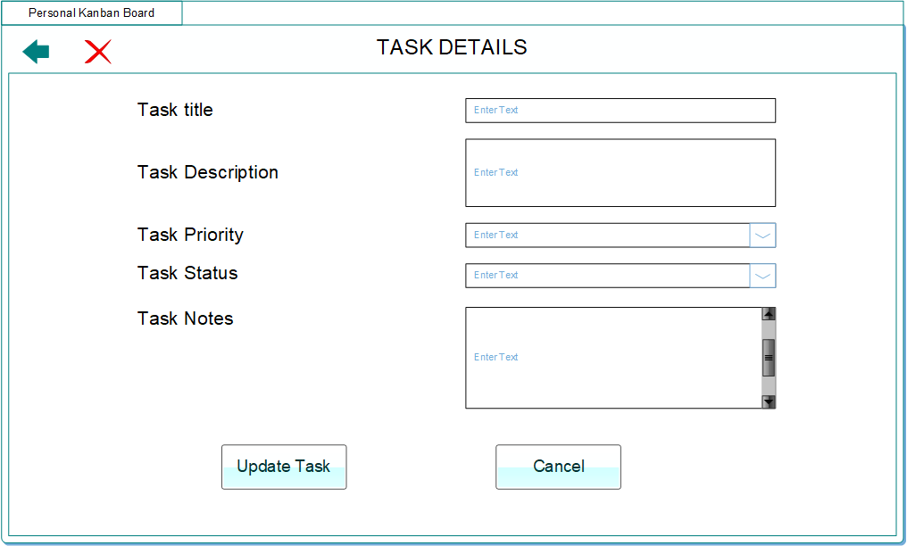
Wire-frames

Slide 9
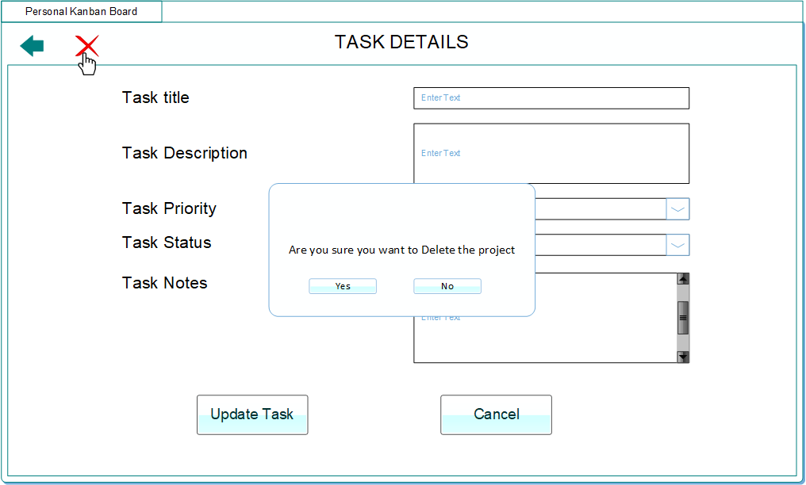
Wire-frames

Slide 10
Thank You

